Slide 1
Google Classroom
From now on, the school will set homework through Google Classroom, not Go4schools.
Go4schools will continue to be the site to check for your behaviour, attendance, grades etc.

Slide 2
Sign in
Go to classroom.google.com
Sign in with the email username@fortismere.school(Your username is what you use to log into the school computer).
Use the same password as on school computers.

Slide 3
You can join individual classes if you know their class code, but you should automatically be enrolled into all your classes for this year.
If there are any classes you are not enrolled in, you can solve this yourself by finding out the class code and joining the class yourself.
Subjects will be setting up extra classes which you can join, for example a classroom for all Year 11 English with useful revision materials.

Slide 4
How to see all the work that is due

Slide 5
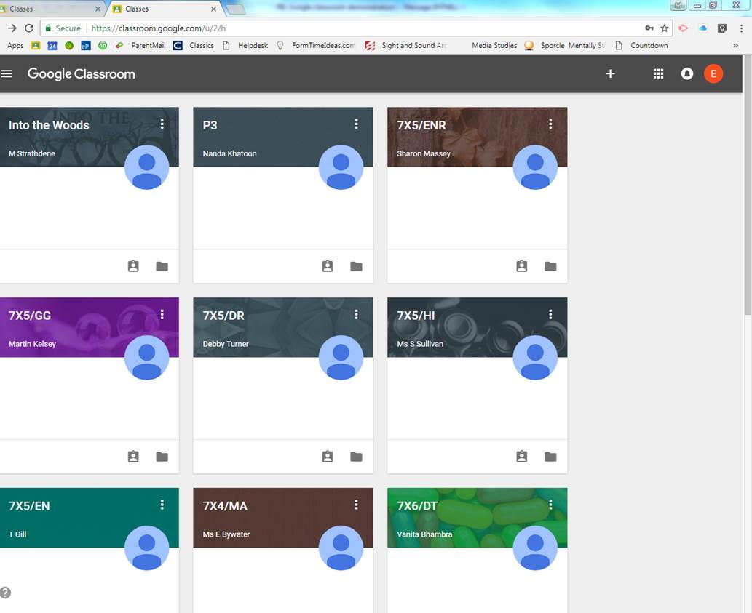
Click on the three lines in the top left hand corner

Slide 6
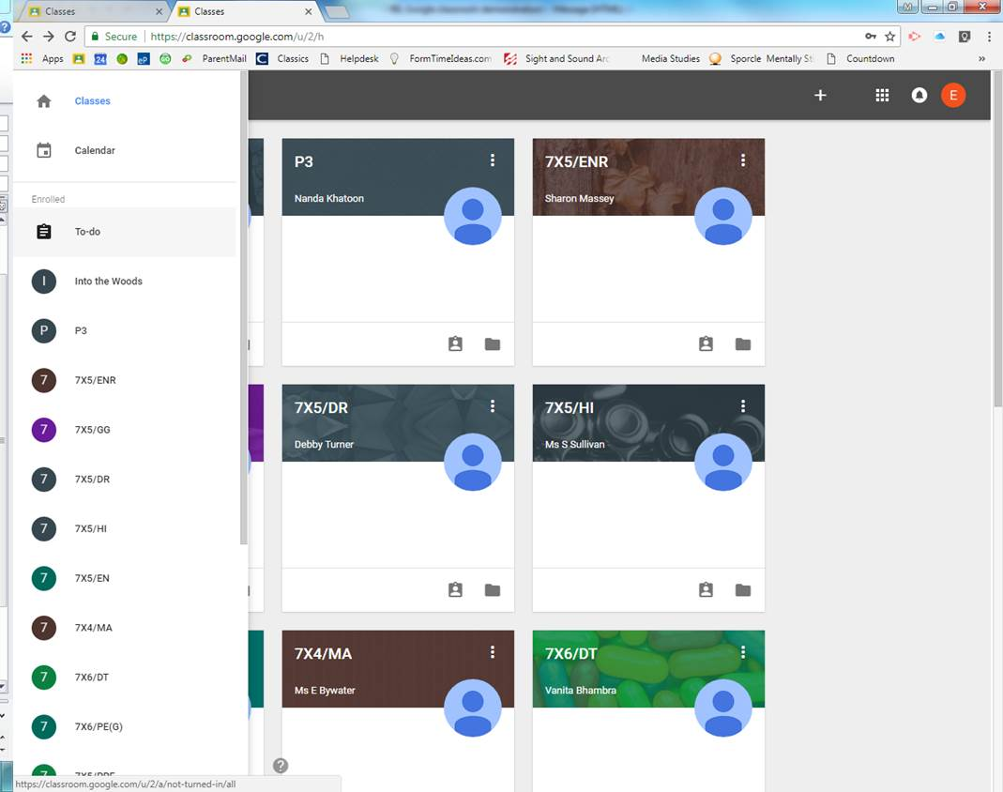
Click on “To-Do”

Slide 7
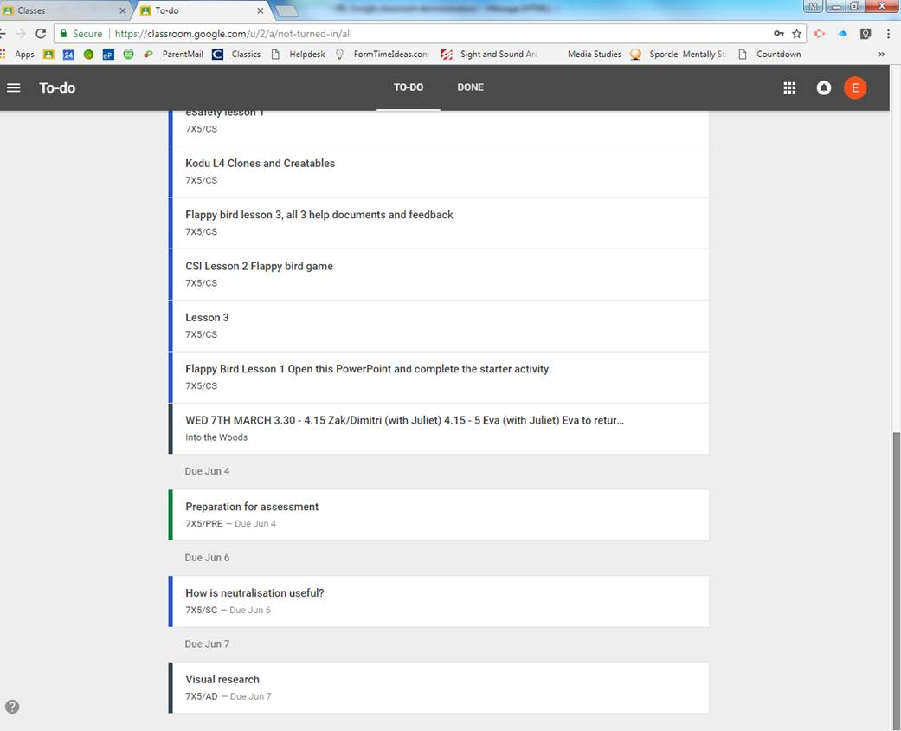

Slide 8
Once you have completed a homework, you either hand it in online or you mark it done yourself.

Slide 9
Click on “MARK AS DONE”

Slide 10
Notifications
You can receive an email and mobile notification from Classroom whenever:
A teacher invites you to a new class.
A teacher creates a new assignment, question, or announcement.
A teacher grades or returns work.
Anyone comments on your post or mentions you in a post or comment.
You have unsubmitted work that's due within 24 hours.
You can turn email and mobile notifications on or off for each class.

